Slide 1
Harmonic Progression
Rubyeat Islam

Slide 2
Arithmetic Progression
There must be a fixed interval between any two digits in a series.
There must not be any other reason for the numbers to come in that order.
Ther numbers either increase or decrease.

Slide 3
Example of AP?
8, 13, 18, 23, 28, 33
Here we have an AP, because there is a fixed gap and the series is increasing in a series we have e terms:
a = first term = 8
d = difference between any two terms = 5
n = number of terms

Slide 4
Basic formula of AP?
In order to find sum of some terms, you can use any of these formula:
n/2 (2a + (n - 1 ) d )
n/2 (first term + last term)

Slide 5
Example of the formula:
What will be the sum of first 100 terms of this series:
8, 13, 18, 23, 28, ….
n/2 ( 2a + (n - 1) d)
n= 100, a=8, d = 5
100/2 (2* 8 + (100 - 1) * 5)
=50 (16 + 495)
=25550

Slide 6
How to identify a term in an AP?
In order to identify any term, use this formula:
Tn = a + (n -1) d
What is 30th term in this series:
8, 13, 18, 23, 28, …
= 8 + (30 - 1) 5
= 8 + 145
= 153

Slide 7
What will be 17th term in the series: 103, 123, 143, 163, ..?
Tn = a + (n - 1) d
Where a = 103, d= 20, n = number of term
= 103 + (17 - 1) * 20
= 103 + 320 = 423

Slide 8
Another problem
There are 31 terms in an AP. The first term is 100340 and the last term is 100580. What is the sum of that series?
Formula: n/2 * (first term + last term)
n = 31, first term = 100340, last term = 100580
= 31/2 * (100340 + 100580)
= 3114260

Slide 9
What is harmonic progression?
A harmonic progression is a sets of values that, once reciprocated, results to an Arithmetic progression. To check, the reciprocated values must possess a rational common difference. Once this has been identified, we may say that the sequence is a Harmonic Progression.

Slide 10
Harmonic Mean
Harmonic Means are the terms found in between two terms of a harmonic progression.

Slide 11
What is harmonic progression?
It is just reverse of AP
For example: 2, 4, 6, 8 in AP
HP = ½, ¼, ⅙, ⅛
Harmonic progression will convert into AP when you reverse it.

Slide 12
Find HM between 20 and 30?
AM = (20 + 30) /2 = 25
HM = reverse of ½ (1/20 + 1/30 ) = 24

Slide 13
Problems
Determine which of the following are Harmonic Progressions:
1, 1/2 , 1/3 , 1/4, ….
1, 1/4 , 1/5 , 1/7 , …

Slide 14
Solutions
Step 1: Find the reciprocals
The reciprocals are: 1, 2, 3, 4, …
Step 2: Identify whether the reciprocated sequence is an Arithmetic Progression by checking if a common difference exists in the terms.

Slide 15
Answer
So,
It is a Harmonic Progression
It is not a Harmonic Progression

Slide 16
Problems
Determine the next three terms of each of the following HP.
24, 12, 8, 6, ,,,,
Solution:
24, 12, 8, 6,...
= 1/24, 1/12, 1/8, 1/6,....
To find the common difference:
1/12 - 1/24
= 2/24 - 1/24
= 1/24

Slide 17
Note:
You can subtract the second term to the first term, the third term to the second term, the forth to the third term, and so on and so forth.

Slide 18
So now:
To get the next three terms:
5th Term = 1/6 + 1/24
= 4/24 + 1/24
= 5/24
Reciprocate
= 24/5

Slide 19
6th Term = 5/24 + 1/24
= 6/24
Reciprocate
= 4

Slide 20
7th Term = 1/4 + 1/24
= 6/24 + 1/24
= 7/24
Reciprocate
= 24/7
So the three terms are: 5/24, 4 and 24/7

Slide 21
Problem
Find the Harmonic Mean between the following terms:
12 and 8
Solutions:
The reciprocals are: 1/12 and 1/8

Slide 22
Step 2: Arrange the given terms as follows:
1/12 Harmonic Mean 1/8
1st Term 2nd Term 3rd Term

Slide 23
Formula
Tn = a + (n - 1) d
Now we may find T3
So
T3 = 1/12 + (3 - 1 ) d
1/8 - 1/12 = 2d
(3 - 2) / 24 = 2d
(3 - 2) = 48d
1 = 48d
d = 1/48

Slide 24
After getting the common difference, add it to the first term to get the Harmonic Mean between the two terms.

Slide 25
T2 = a + d
= 1/12 + 1/48
= (4 + 1) / 48
= 5/48
Reciprocate
= 48/5

Slide 26
Problem
Insert three Harmonic Means between the following terms:
36 and 36/5
Solution:
The reciprocals are: 1/36 and 5/36
Arrange the given terms as follows:

Slide 27
Formula
Tn = a + (n - 1 ) d
Same as before, at first find d
T5 = 1/36 + (5 - 1 ) d
5/36 - 1/36 = 4d
(5 - 1) /36 = 4d
4/36 = 4d
d = 1/36

Slide 28
Now, after getting the Common Difference, add it to the first term, then add it to the second term, and then add it it to the third term to get the Harmonic Mean between the two terms.

Slide 29
So,
T2 = t1 + d
= 1/36 + 1/36
= 1/18
Reciprocate
= 18

Slide 30
T3 = t2 + d
= 2/36 + 1/36
= 3/36
= 1/12
Reciprocate
= 12

Slide 31
T4 = t3 + d
= 3/36 + 1/36
= 4/36
= 1/9
Reciprocate
= 9
So there terms between 36 and 36/5 are 18, 12 and 9

Slide 32
Homework
Determine if the following are harmonic progressions or not:
1/12, 1/24, 1/36 ->reciprocals:12,24,36 .As diffn same so Harmonic
2, 5, 7, 8 ->reciprocals:1/2,1/5,1/7,1/8.As diffn not same.So not Harmonic
1/5 , 1/10, 1/15 ->reciprocals:5,10,15.harmonic

Slide 33
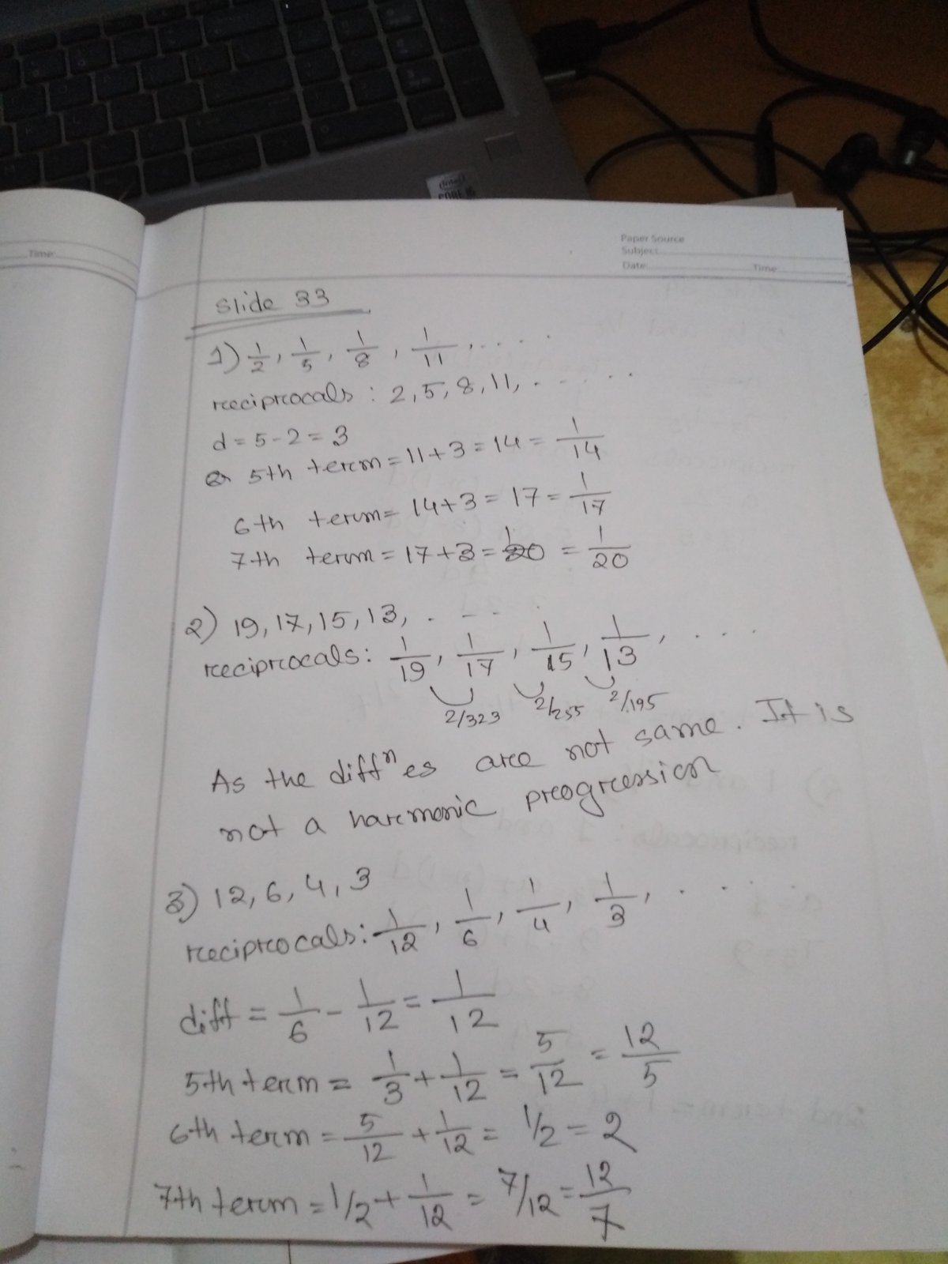
Find the next three terms in
the following harmonic progressions
1/2, 1/5, 1/8 , 1/11, …..
19, 17, 15, 13, …..
12, 6 , 4, 3, ….

Slide 34
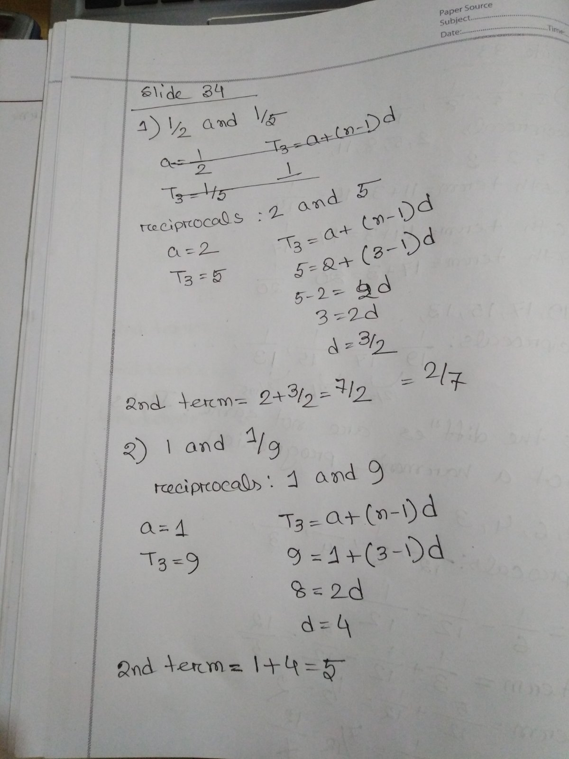
Find the harmonic
mean between
1/2 and ⅕
1 and 1/9

Slide 35
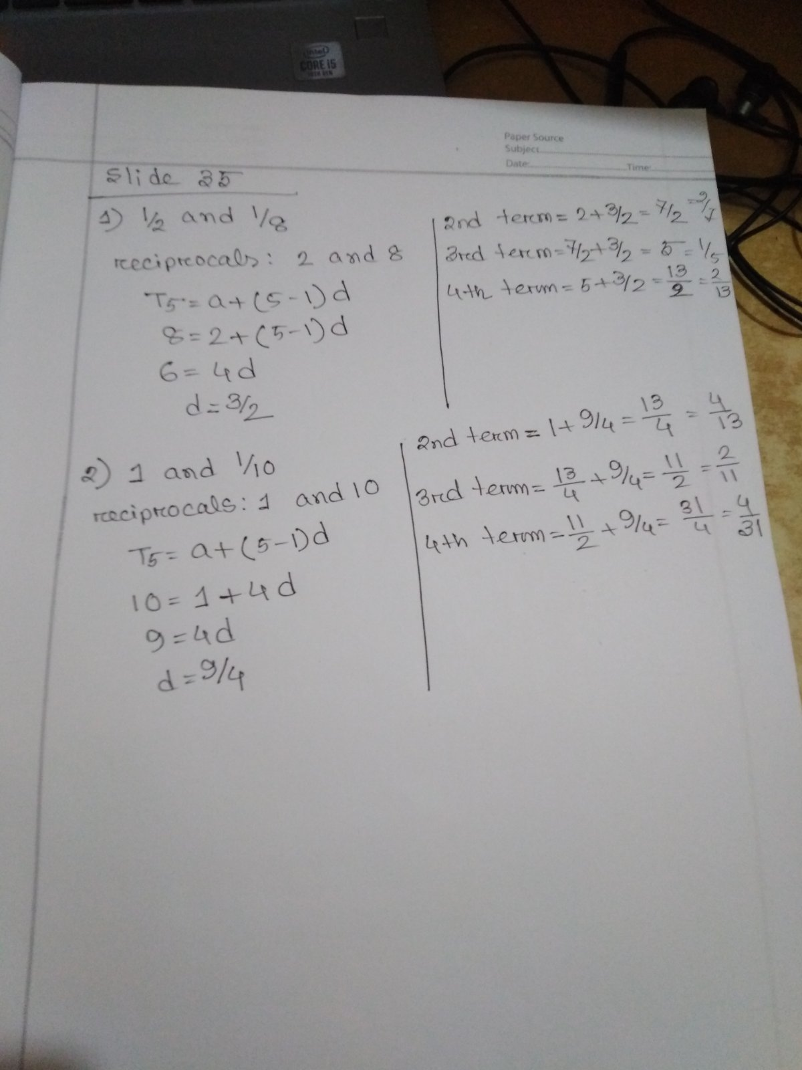
Insert three harmonic
means between:
1/2 and 1/8
1 and 1/10

Slide 36
Geometric Progression
When a series is rising at an increasing fast speed, it is geometric progression.
Example:
2, 4, 8, 16, 32, 64, ….. Here a = 2 (starting term)
Ratio = 16/8 = 2 (you may pick up any two terms, the ration will be the same)

Slide 37
Essential components of GP?
Take any GP: Let us say: 3, 9, 27, 81, 243
There are 3 terms:
Starting term a = 3
Growth ratio of two terms: r = 27/9 = 3
n = number of terms = n = 5

Slide 38
Can ratio be less than 1?
The answer is Yes.
In that case the series will be a decreasing series
Example:
81, 27, 9, 3, 1, 1/3, 1/9 , 1/27, …….

Slide 39
What is the sum of this series for 5 terms:
1^2, 2^2, 3^2…..
Formula: ( n (n + 1) (2n + 1) ) / 6
= (5 (6) (11) ) /6
=55

Slide 40
What is the sum of this series for 5 Terms:
1^3, 2^3, 3^3, …….
Formula: n (n (n + 1) / 2) ^ 2)
= (5 (5 + 1) /2 )^ 2
= 225

Slide 41
What is the sum of this infinite series: 512, 256, 128, 64…for first 10 terms?
Solution:
Formula = a/ (l - r )
a = 512, r = 256/512 = ½ = .5
= 512 / (1- .5)
= 1024

Slide 42
What is the sum of this series:
2, 4, 8, 16 for first 30 terms???
Sn = a (r ^n - 1) / (r - 1)
a = 2 , r = ratio, n = 30
= 2 ( 2^30 - 1) / (2 - 1(
= 2 * 1073741823
= 2147483646

Slide 43
What is the sum of first 8 terms of this series:
8, 64, 512
a (r ^n - 1) / (r - 1)
a= 8, r= 8, n = 8
8 (8^8 -1) / (8 -1)
= 19173960

Slide 44
What is the sum of first 5 terms of this series:
81, 27, 9
a (1- r^n) / (1 -r)
= 81 (1- (⅓) ^ 5) / (1 - (⅓))
= 121

Slide 45
Which of this is geometric progression?
3, 5, 88, 122 ->Not
3, 5, 7, 9, 11, ….->Not
4, 16, 64, 256, ….->Yes

Slide 46
In order to study at Hyderabad, Maynak starts saving money. First day he saves Rs. 200000. Next day he saves half of this money. This process continues. Now this becomes his habit. If Maynak continues saving like this, how much money can he save in his lifetime?
Formula:
a/ (1-r)

Slide 47
Thank You!!

